Slide 1
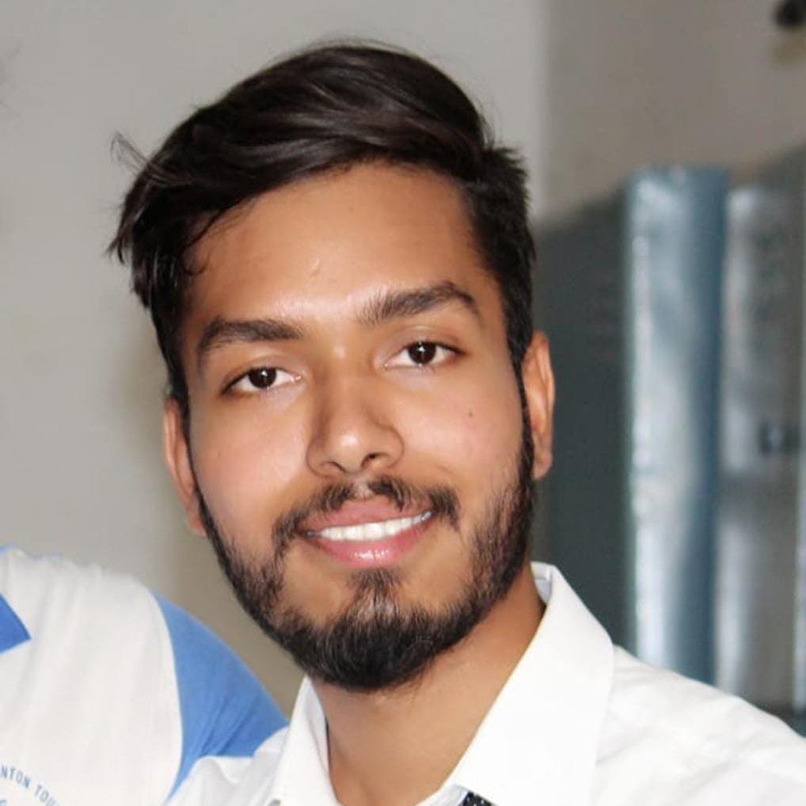

Omprakash.T
Bachelor OF Technology:
2018 - 2021
Skills
Java
Spring Boot
Spring MVC
Manual Testing
Backend
Java
Spring Boot
Spring Security
REST API
Database
MongoDB
SQL
Web Technologies
HTML5
CSS3
Add-ons
Git and GitHub
Postman
Additional Details
Team management
Analyst/Software Engineer
Bangalore
Omprakash.T@capgemini.com
+91 8073005653
A4
A self driven learner with Front-End and Back-End knowledge. Passionate about implementing and launching new projects.
Ready to learn new technologies/Frameworks and implement them to further improve my knowledge.
A team player with good communication skill always ready to work for the enrichment of knowledge.
Has working knowledge on Java Microservice Development using Spring framework on an intermediate level. Also Implemented Eureka Server in case study and upskilling day by day.
Software Engineer who is Strong in design and integration with intuitive problem-solving skills. Passionate about implementing and launching new projects.
1.Medical Store Management Application
Developed Medical Store Management application on JAVA using spring framework and microservices. Used Postman and the client software for the first stage of the case study assessment during training program.
2. Completed Git, GitHub at Capgemini Degreed Platform
Learnt the concepts of Git and GitHub, simultaneously applied the concepts for better learning.
3. Pursuing iTransform: Full Stack Angular, Spring Boot MS & MongoDB at Capgemini Degreed Platform.

